Slide 1
Blockchain based Certificate Authentication System

Slide 2
Team Members
Akhil M Reji (2020BCS0059)
Christo Sojan (2020BCS0069)
M S Vamsi (2020BCS0049)
Harsh Gupta (2020BCS0187)

Slide 3
Problem Statement
The ordinary certificate verification is a very slow process and takes a lot of steps, involves a lot of man work.
Tampered or forged certificate which looks too real and cannot be traced.

Slide 4
Problem Solution
Creating a decentralized blockchain application.
It is traceable, tamper proof, and encrypted.
Tackle the problem of fake certificates.
We will use Smart Contract at backend to interact with the blockchain and the encrypted hash value of each document will be stored in blockchain which will be verified against the user document.

Slide 5
Purpose
This Application can issue certificate by storing the certificate detail in blockchain.
It provide an NFT with unique Id printed on the certificate.
Anyone with the unique Id of the NFT can verify & authenticate the details of the certificate.
It can easily scaled to include all college event including both academics and sports.
Our software can be associated with any public or private organisation for issuing and verifying certificate to the respective audience.

Slide 6
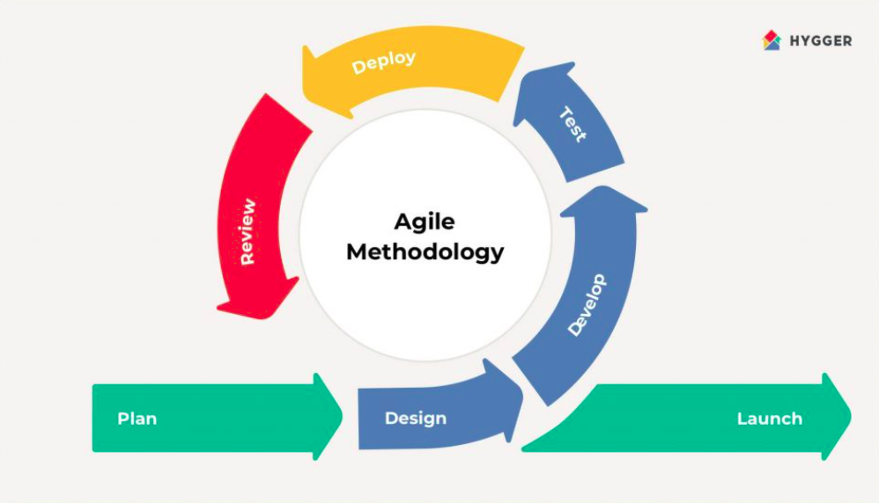
SDLC Model

Slide 7
Requirements Specification

Slide 8
External Interfaces
User Interface Requirements
The software will use a Graphical User Interface coded using React Framework which is built on top of HTML, CSS and JavaScript.
Interface for the event organizer to create certificates using metadata form.
Interface for the recruiters to check over the token id on the blockhain
Hardware Interface Requirements
Any device that can connect to the internet and access a browser
Support for 32-bit/64-bit Processor: Dual Core RAM:2 GB
Hard Disk:320 NIC: For each party
Software Interface Requirements
Windows 10/11, MacOS 11+, Linux/GNU, Android 9+, iOS 13+.
MetaMask extension

Slide 9
Functional Requirments
Collect meta data of certificate to be issued by authority
Generate NFTS using the meta data
Store all the generated unique ID
Append the unique key generated from nft into the certificate
Function to verify the authenticity of the certificate by any third party
Maintain data of college which are associated with DCS

Slide 10
Other Functionalities
The entire backend logic and database is built over blockchain using smart contracts.
The data from the front-end is transferred to the blockchain using blockchain API.
Then the API calls the appropriate functions to process the data and fetch results accordingly from the smart contract.
The results are then displayed to the user in the web interface

Slide 11
Logical Database Requirements
The database we are using is smart contract based over blockchain
CRUD operations could be performed by the described functions
The contract could be improved and updated with the use of DAO.
The database is secured and decentralised.

Slide 12
Design Specifications
In this model, the Admin/University will be responsible to upload the student’s academic details into the blockchain using Dapp upon which a unique Certificate Id will be generated and the same will be sent to the respective student email. Now if the company is looking to hire an applicant.
The student/applicant will have to share his/her unique Certificate Id with the recruiter, the same Id is used to view and verify the authenticity of a certificate.
Since the Certificates are in blockchain, Data immutability and Security are strictly maintained. Overall, developing a Decentralized application that is universally accessible for students/employers to view and verify academic certificates without any third-party involvement, which is very simple to use, also efficient which will make a major impact in the near future.

Slide 13
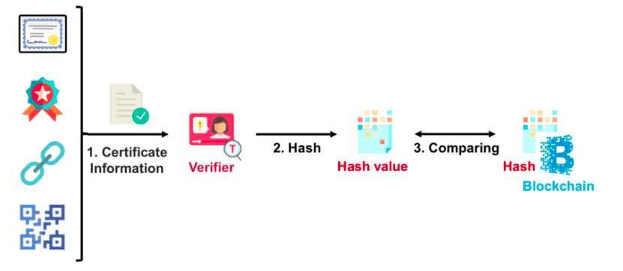
System Diagram

Slide 14
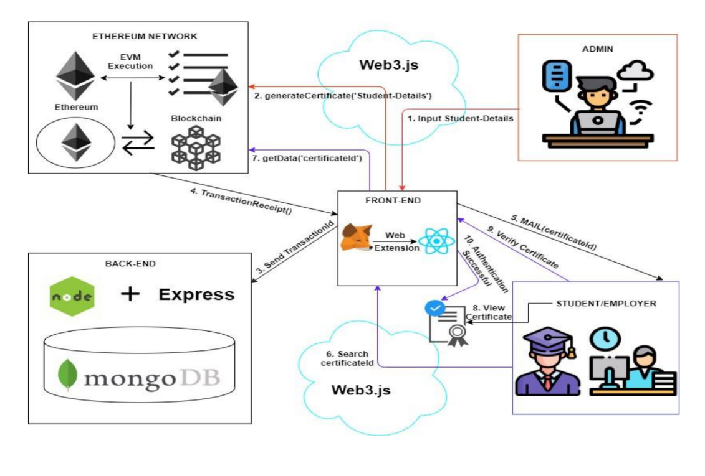
Architecture Design

Slide 15
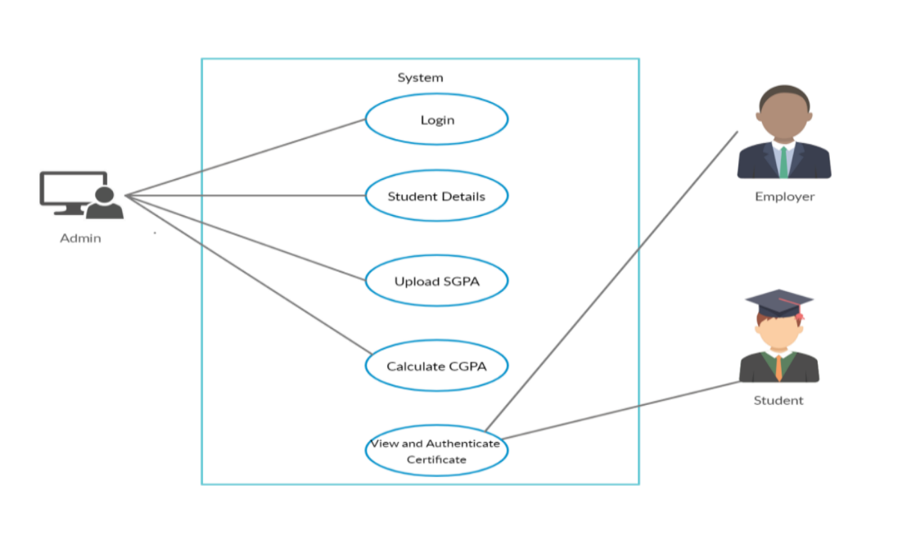
Use Case Diagram

Slide 16
Workflow / Sequence Diagram
Step 1: Admin will fill student academic details in a form provided using Dapp interface.
Step 2: Admin submits the pre-viewed form details to Ropsten Blockchain Network.
Step 3: When the certificate is uploaded into Blockchain. Certificate Id is generated and sent to respective student email.
Step 4: Students can share the Certificate Id for certificate verification.
Step 5: With the help of Dapp Interface Company HR can verify the certificate.
Step 6: Verification of Certificate Id query request will take place.
Step 7: Query result is displayed i.e., verified or failed.
Step 8: HR can confirm the certificate.
Step 9: The student will use his Certificate Id to view the certificate.
Step 10: Query request to search Certificate Id in the blockchain.
Step 11: Query result for the Certificate Id will be displayed.
Step 12: Students can view their Certificate.

Slide 17
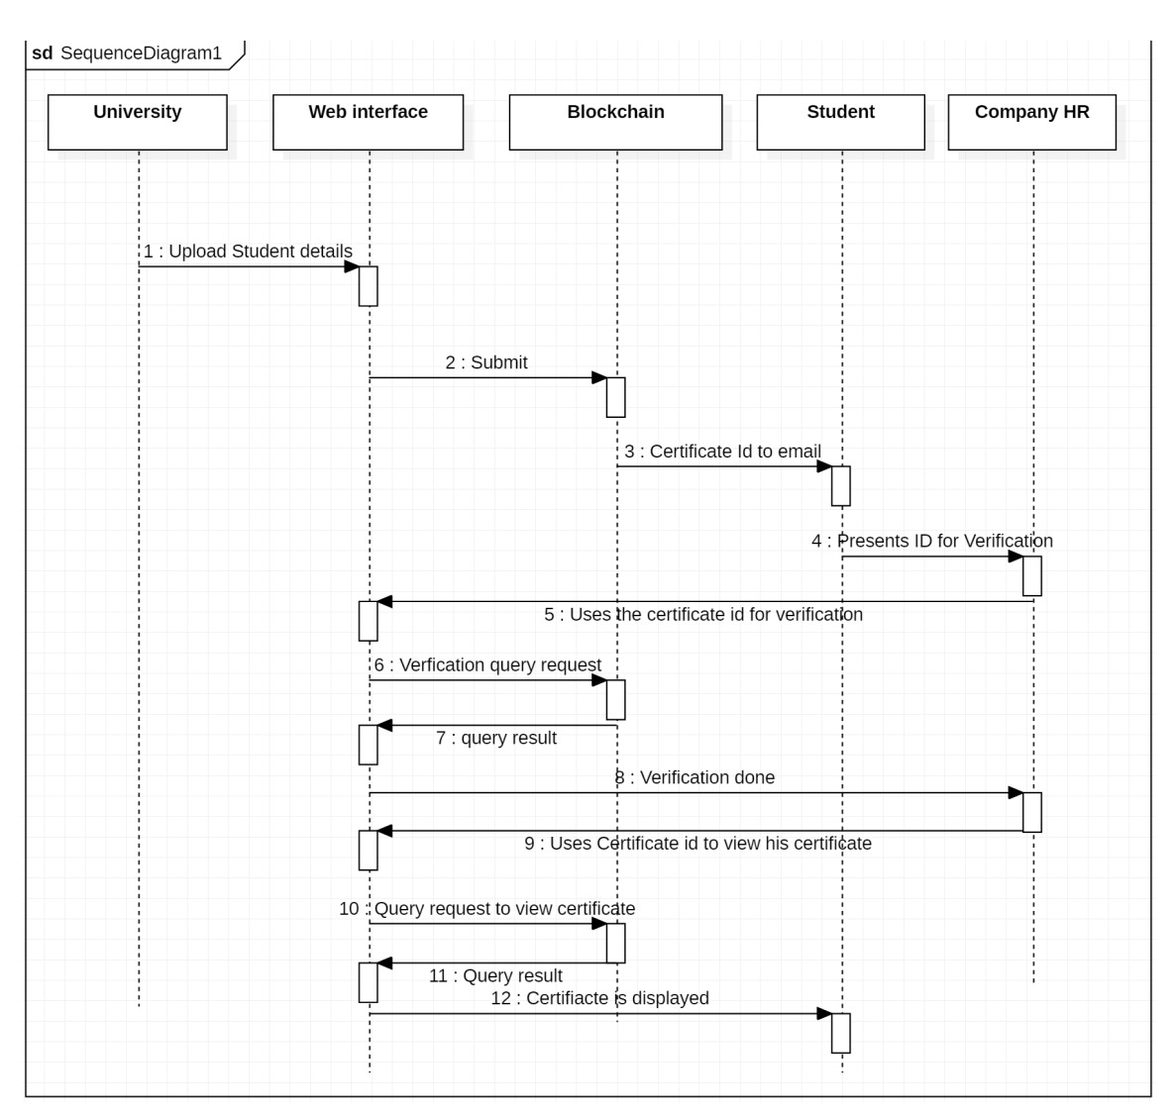

Slide 18
Test Plan
Functionality testing :- to check if the given features are working properly.
Usability testing :- When a user wants to create certificates , the whole process of adding metadata and deploying on required chain should be simple.
Security testing :- smart contract auditing and vulnerability testing.
Performance testing :- ensures that our product can handle millions of users concurrently.
Mobile application testing

Slide 19
General Test cases
The user should be able to navigate all the pages.
There should be a fallback page for any load errors.
Created certificates should return the correct token ID.
The verification of the token ID should return the correct metadata.
Vulnerability testing of the smart contract.

Slide 20
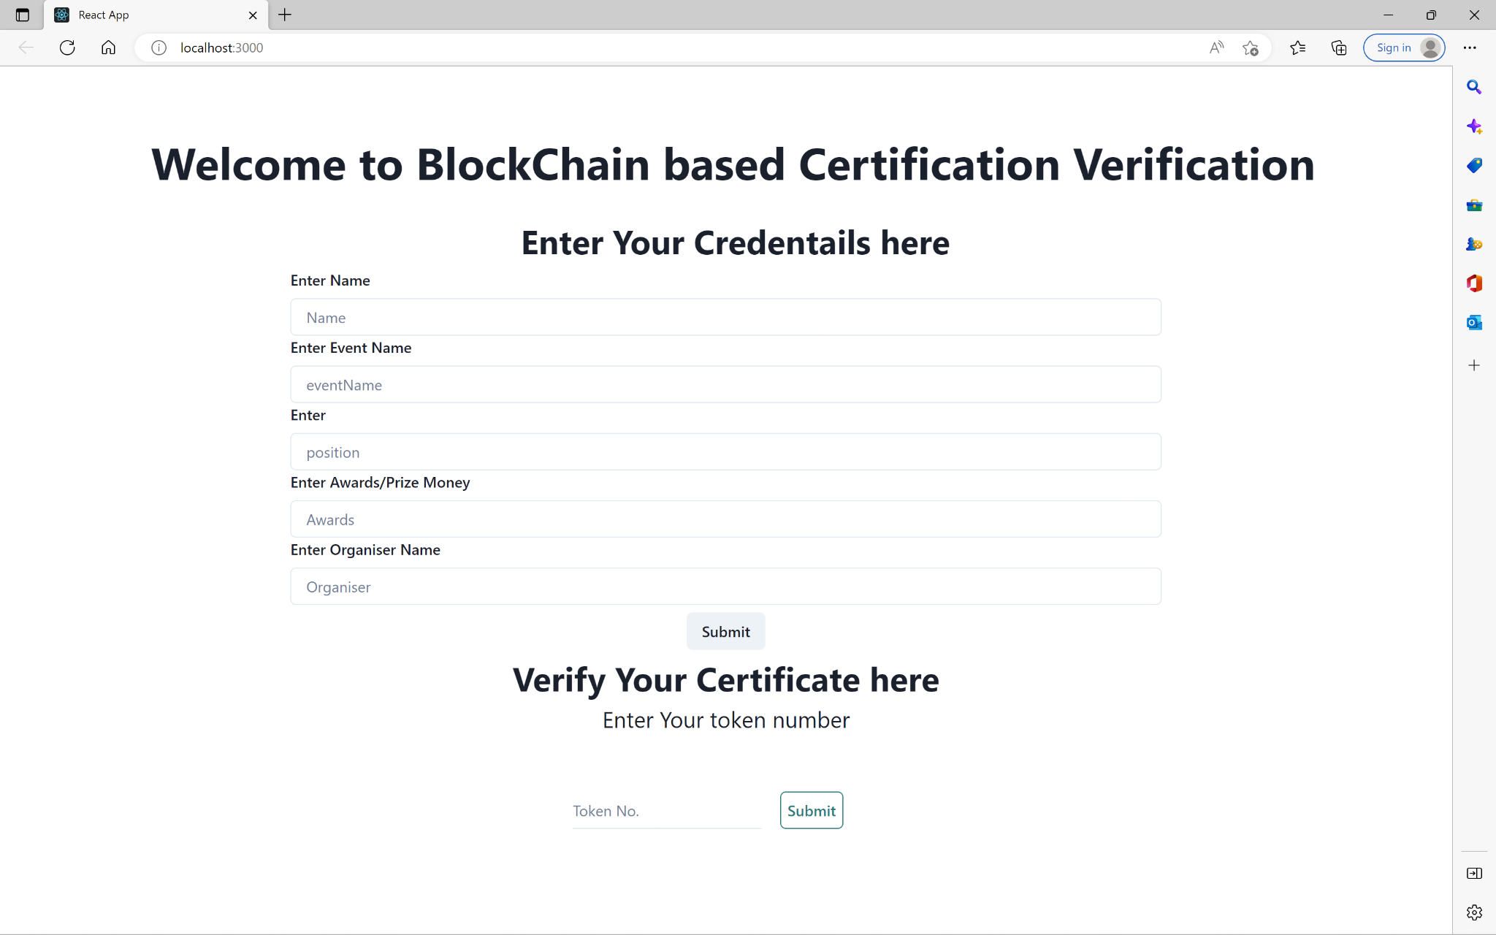
Demo of our Product

Slide 21
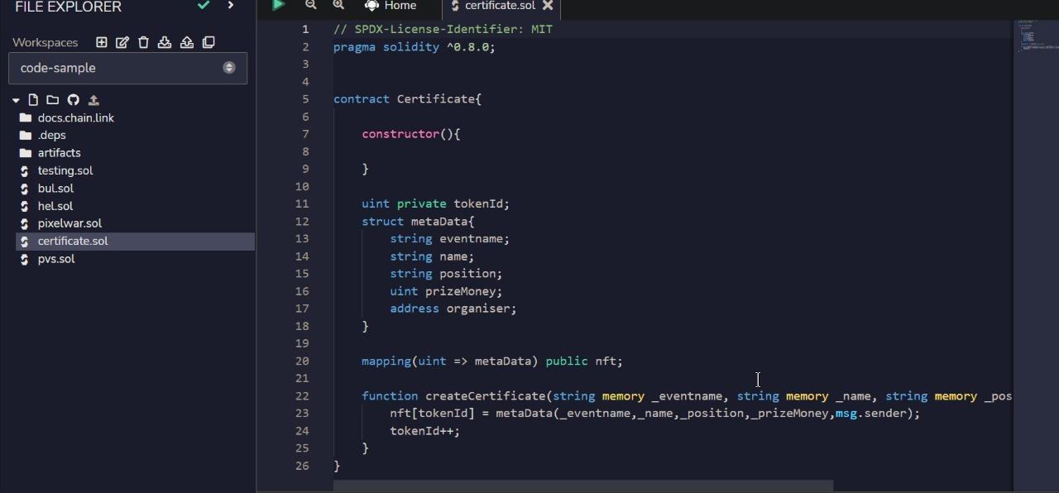
Smart Contract

Slide 22
Thank You

